Slide 1
Watch the video below. With a seat partner predict what might have happened.
https://www.youtube.com/watch?v=tuZxFL9cGkI
You may have come up with a prediction of static electricity.
Yes, static electricity played a part, but what does it actually mean?
We will find out in the next few days.
Notes:
Instructional Approach(s): The teacher should use the slide to activate students prior knowledge. The teacher can pose the questions to the class, individual students, or let the students pair up to answer the questions. The teacher should not spend more than 5 minutes on the slide. When ready, the teacher can click the mouse to show the answers.

Slide 2
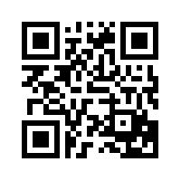
Essential Question:
How do electric charges exert force on each other?
Standard:
S8P5c. Investigate and explain that electric currents can exert force on each other.
Notes:
Instructional Approach(s): The teacher should introduce the essential question and the standard that aligns to the essential question

Slide 3
Standard:
S8P5c. Investigate and explain that electric currents can exert force on each other.
What does exert mean?
Exert simply means to apply or use.
Notes:
Instructional Approach(s): The teacher should introduce the standard that aligns to the essential question and explain “exert”.

Slide 4
Turn to a seat partner and define Force?
A force is a push or a pull
Notes:
Instructional Approach(s): The teacher can pose the questions to the class and let the students pair up to answer the questions. The teacher should not spend more than a few minutes on the slide. When ready, the teacher can click the mouse to show the answers. The teacher should present the information on the slide while the students record the important information on their notes

Slide 5

Have you ever reached out to open a door and received a shock from the doorknob?
In order to understand why this happens, you have to understand electric charges.
Notes:
Instructional Approach(s): The teacher should present the information on the slide.

Slide 6
All matter is made up of very small particles called ______
atoms
Atoms are made of even smaller particles called ___________________________
Protons, Neutrons, Electron
Notes:
Instructional Approach(s): The teacher should present the information on the slide while the students record the important information on their notes

Slide 7
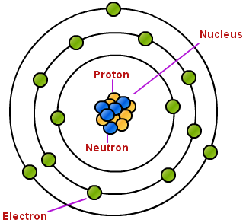
Protons and Neutrons make up the center of the atom, the nucleus. Electrons are found outside the nucleus.
Notes:
Instructional Approach(s): The teacher should present the information on the slide while the students record the important information on their notes

Slide 8
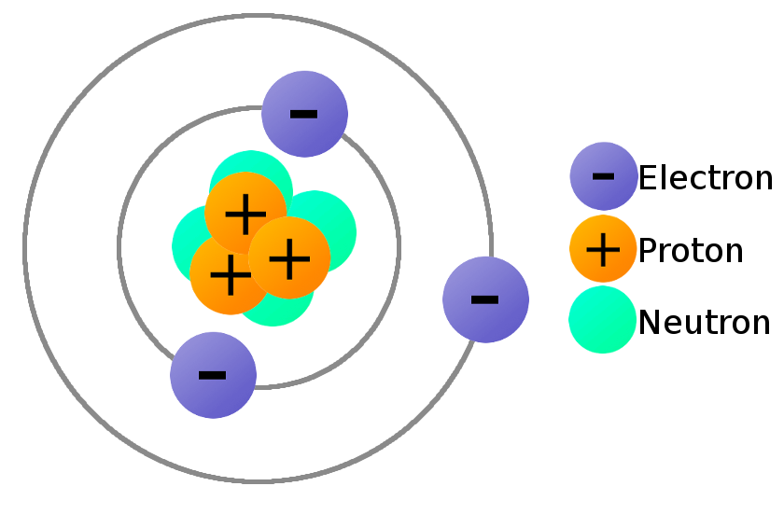
Protons and Electrons are charged particles, and neutrons are not.
Notes:
Instructional Approach(s): The teacher should present the information on the slide while the students record the important information on their notes

Slide 9
Charge is a physical property.
An object can have a positive charge, a negative charge, or no charge.
Notes:
Instructional Approach(s): The teacher should present the information on the slide while the students record the important information on their notes

Slide 10
Charged objects exert a force – a push or a pull – on other charged objects.
Notes:
Instructional Approach(s): The teacher should present the information on the slide while the students record the important information on their notes

Slide 11
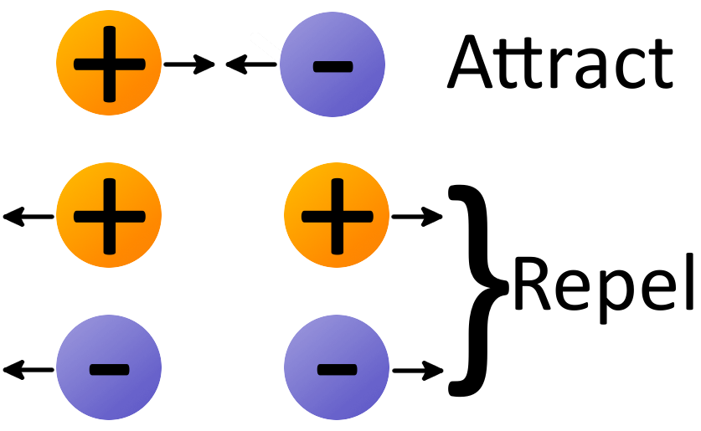
Charges Exert Forces
Notes:
Instructional Approach(s): The teacher should present the information on the slide while the students record the important information on their notes

Slide 12
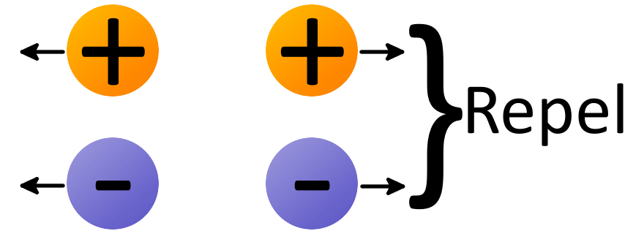
Objects that have the same charge repel each other.
Each object exerts a force on the other object. These forces push the objects apart.
Notes:
Instructional Approach(s): The teacher should present the information on the slide while the students record the important information on their notes

Slide 13
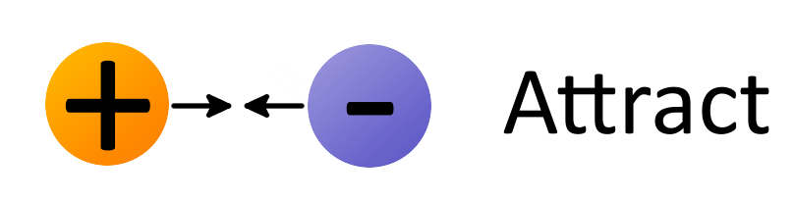
Objects that have opposite charges are attracted to each other.
Each object exerts a force on the other object. These forces pull the objects together.
Notes:
Instructional Approach(s): The teacher should present the information on the slide while the students record the important information on their notes

Slide 14
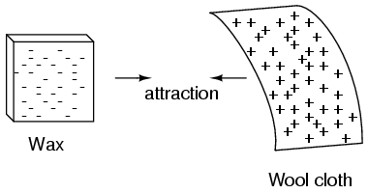
Notes:
Instructional Approach(s): The teacher should present the illustration on the slide to provide an example of how opposite charges attract

Slide 15
In atoms, protons are positively charged. Electrons are negatively charged.
Because protons and electrons have opposite charges, they are attracted to each other. Without this attraction, electrons would fly away from the nucleus of an atom.
Notes:
Instructional Approach(s): The teacher should present the information on the slide while the students record the important information on their notes

Slide 16
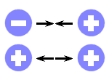
Attract or Repel Activity
Notes:
Instructional Approach(s): The teacher should use this slide to reinforce how like and opposite charges react. The teacher can pose the questions to the class, individual students, or let the students pair up to answer the questions. The teacher should not spend more than a few minutes on the slide. When ready, the teacher can click the mouse to show the answers.

Slide 17
Make an
Electroscope
[optional: see resources]
An electroscope is a device used to see if an object is charged. However, it cannot show whether the charge is positive or negative.
Notes:
Instructional Approach(s): The teacher should use the slide to activate making an electroscope.(on the resource page and optional)

Slide 18
The force between charged objects is an electric force.
The greater the charges are, the greater the electric force is between objects.
The closer together the charges are, the greater the electric
force is between objects.
Notes:
Instructional Approach(s): The teacher should present the information on the slide while the students record the important information on their notes

Slide 19
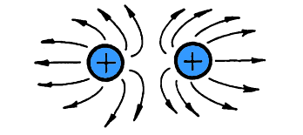
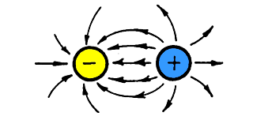
Charged things have an electric field around them.
A charged object in the electric field of another charged object is attracted or repelled by the electric force acting on it.
Notes:
Instructional Approach(s): The teacher should present the information on the slide while the students record the important information on their notes

Slide 20
Electricity is simply the presence and/or flow of electric charges.
Electric
Force
Electric
Field
Electric
Charge
Electric
Force
Notes:
Instructional Approach(s): The teacher should present the illustration and information on the slide while the students record the important information on their notes. Teacher may include student involvement in labeling the charges, forces, and fields. Click the mouse to show the answers.

Slide 21
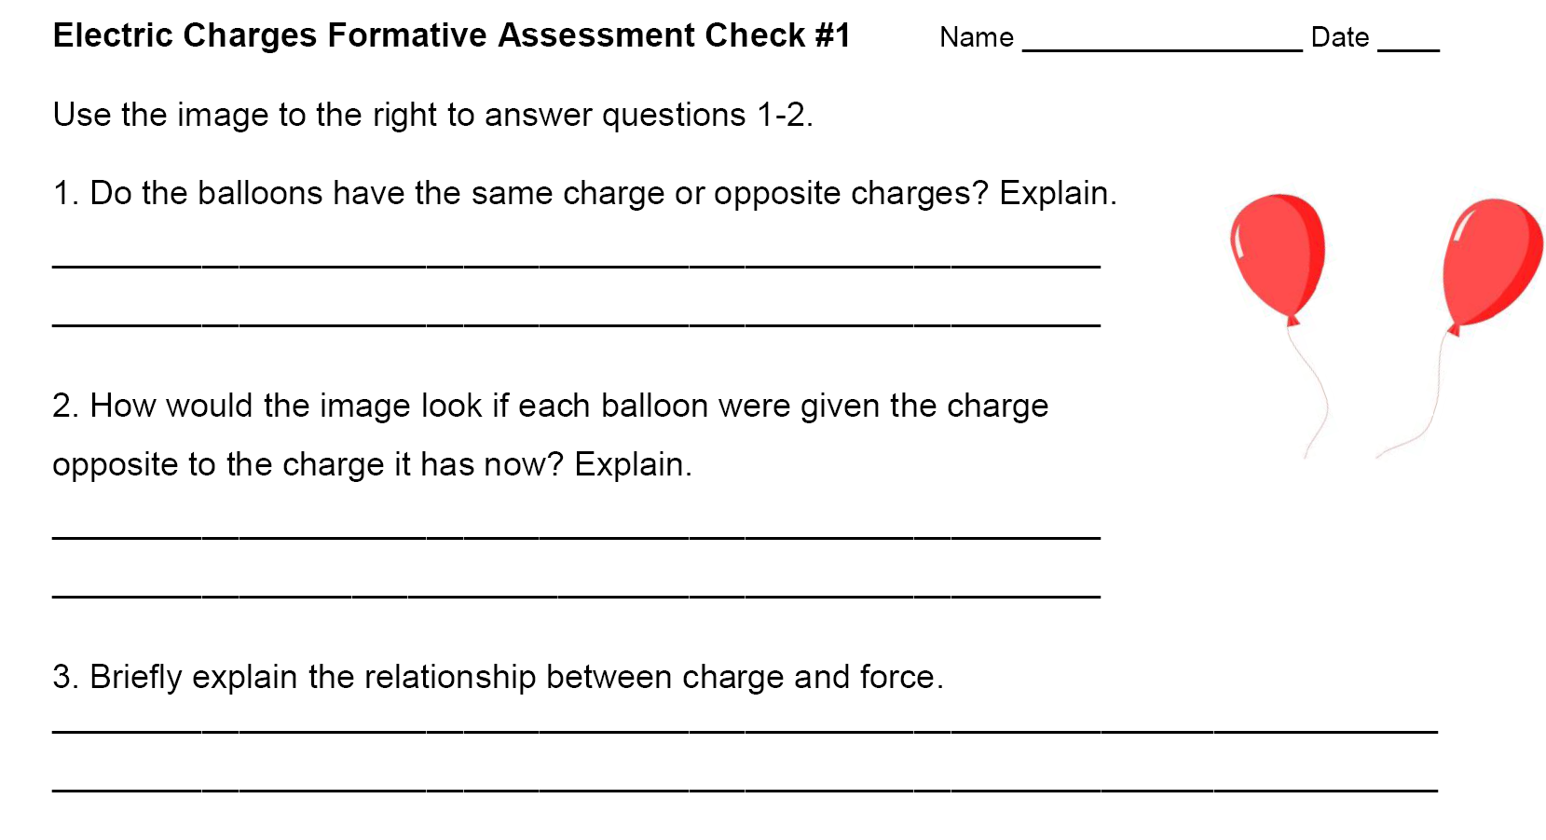
Formative Assessment Check
Notes:
Instructional Approach(s): Formative assessment. Each student should complete the assessment. The teacher should use the assessment to determine the level of student mastery and if differentiation is needed.

Slide 22

Atoms have equal numbers of protons and electrons. Because an atom’s positive and negative charges cancel each other out, atoms do not have a charge.
So, how can anything made of
atoms be charged?
Notes:
Instructional Approach(s): The teacher should present the information on the slide while the students record the important information on their notes

Slide 23
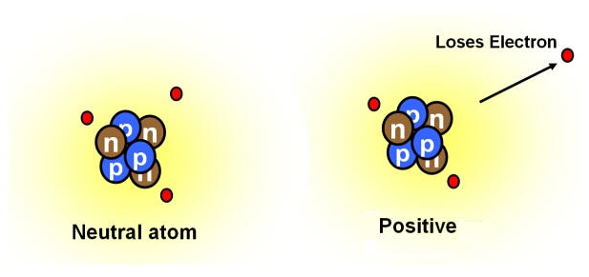
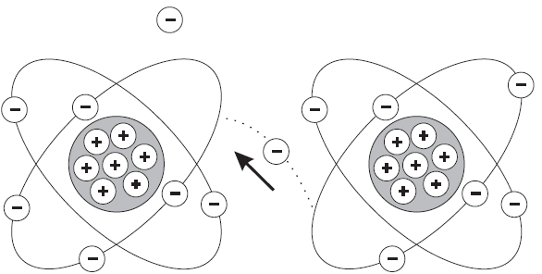
An object becomes positively charged when it loses electrons.
An object becomes negatively charged when it gains electrons.
Notes:
Instructional Approach(s): The teacher should present the information on the slide while the students record the important information on their notes

Slide 24
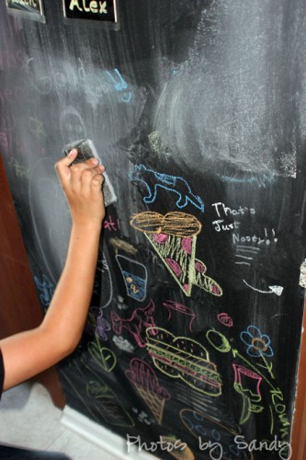
When trying to understand the transfer of electrons, think of a chalk board and eraser. How might this illustrate electron transfer?
The eraser represents a negatively charged object, the chalk particles represent electrons, and the (clean) board represents an uncharged object.
When the board is wiped by the eraser, there is an “electron trail” that the chalk leaves behind.
Notes:
Instructional Approach(s): The teacher should use this slide to reinforce the transfer. The teacher can pose the questions to the class, individual students, or let the students pair up to answer the questions. The teacher should not spend more than a few minutes on the slide. When ready, the teacher can click the mouse to show the answers.

Slide 25
Electrical Charges Worksheet
Notes:
Instructional Approach(s): The teacher should use this slide to introduce the worksheet for practice and reinforcement.(on resource page)

Slide 26
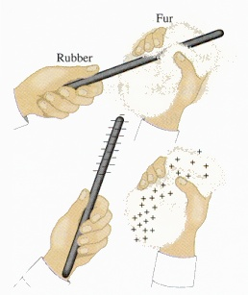
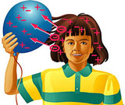
Objects can be charged when electrons are “wiped” from one object onto another (friction).
http://phet.colorado.edu/sims/html/balloons-and-static-electricity/latest/balloons-and-static-electricity_en.html
Notes:
Instructional Approach(s): The teacher should present the information on the slide while the students record the important information on their notes

Slide 27
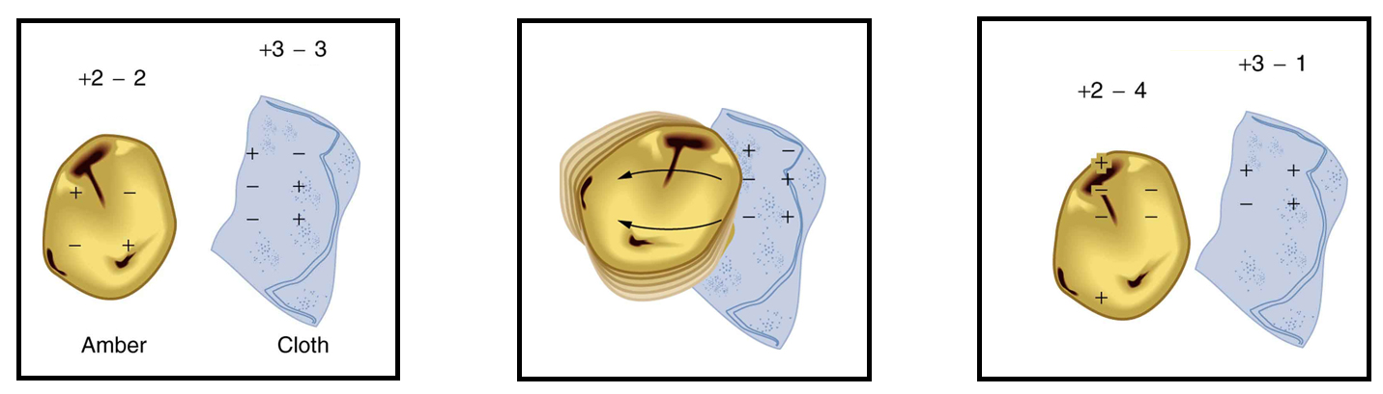
Charge by Friction
What’s the electric charge of the amber after being rubbed by the cloth? What about the cloth?
Notes:
Instructional Approach(s): The teacher should use this slide to reinforce electron transfer by friction. The teacher can pose the questions to the class, individual students, or let the students pair up to answer the questions. The teacher should not spend more than a few minutes on the slide. When ready, the teacher can click the mouse to show the answers.

Slide 28
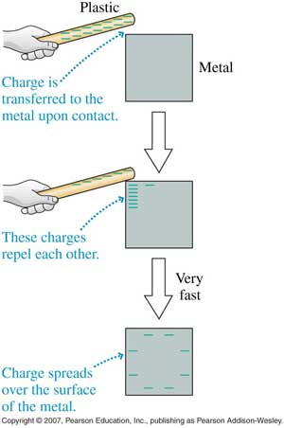
Objects can be charged when electrons move from one object to another by direct contact (conduction).
Notes:
Instructional Approach(s): The teacher should present the information on the slide while the students record the important information on their notes

Slide 29
A Van de Graaff generator is a machine that continuously produces a charge on its domed metal surface.
If you have your hands on the dome, electrons will transfer between you and the dome by conduction, causing your hair to stand on end! Your hair becomes charged, and the like-charged strands of hair repel each other.
https://www.youtube.com/watch?v=jZEFuCxD7BE
Notes:
Instructional Approach(s): The teacher should use this slide to reinforce electron transfer by conduction. The teacher can the Van de Graaff and the youtube video to provide real life examples.

Slide 30
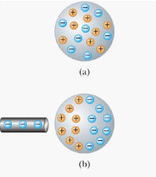
Objects can be charged when charges in an uncharged metal object are rearranged without direct contact with a charged object (induction).
https://www.youtube.com/watch?v=VhWQ-r1LYXY
Notes:
Instructional Approach(s): The teacher should present the information on the slide while the students record the important information on their notes. Teacher can use the youtube video to provide an example of induction.

Slide 31
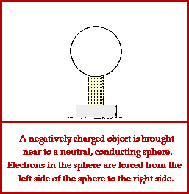
Notes:
Instructional Approach(s): The teacher should use this slide to reinforce electron transfer by induction.

Slide 32
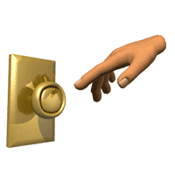
Remember our question earlier about reaching out to open a door and getting shocked? What about the “fire starting” activator?
It all goes back to electrical charges and something called static electricity.
Notes:
Instructional Approach(s): The teacher should use this slide to introduce static electricity. The teacher can pose the questions to the class, individual students, or let the students pair up to answer the questions. The teacher should not spend more than a few minutes on the slide. When ready, the teacher can click the mouse to show the answers.

Slide 33
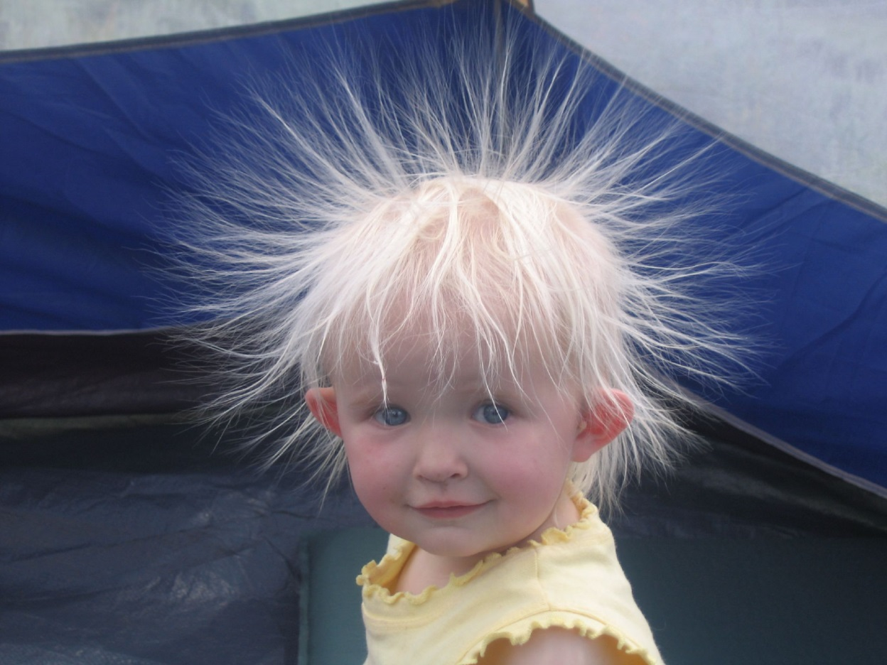
Static Electricity is an electric charge at rest; generally produced by friction or induction.
Notes:
Instructional Approach(s): The teacher should use this slide to provide information to students and for them to write in their notes.

Slide 34
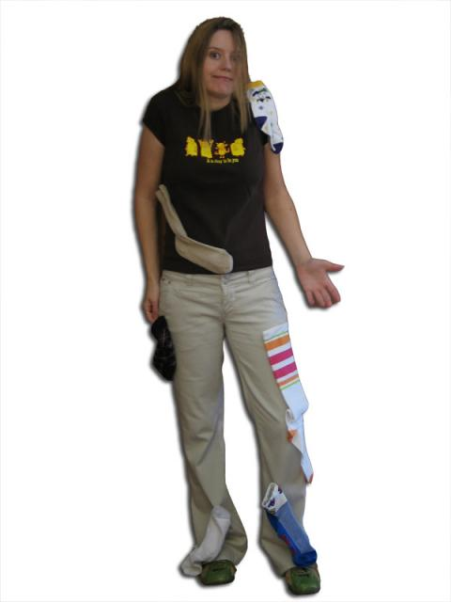
The charges of static electricity do not move away from the object that they are in. So, the object keeps its charge.
Your clothes are charged by friction as they rub against each other inside a dryer. As the clothes tumble, negative charges are lost by some clothes and build up on other clothes.
Notes:
Instructional Approach(s): The teacher should use this slide to provide more information and example to about static electricity

Slide 35
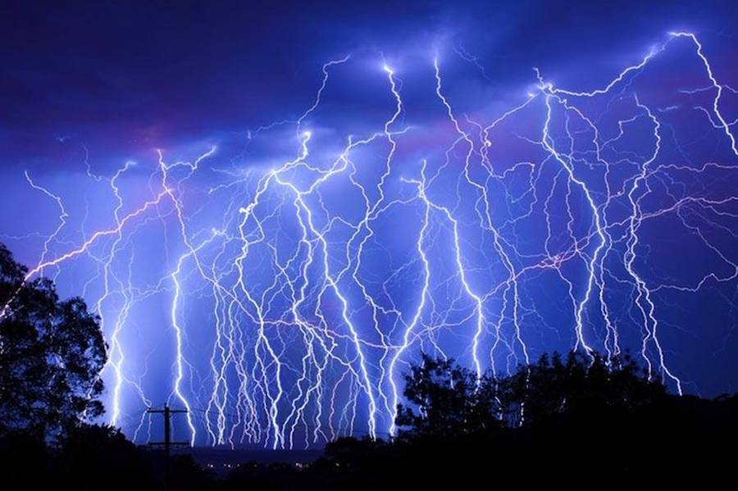
Charges that build up as static electricity on an object eventually leave the object. One of the most dramatic examples is lightning.
Notes:
Instructional Approach(s): The teacher should present the information on the slide while the students record the important information on their notes

Slide 36
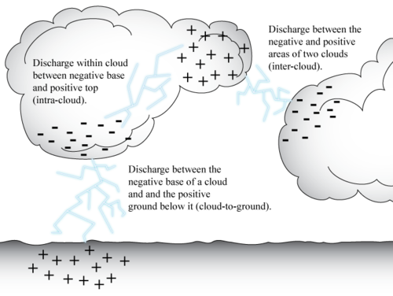
Notes:
Instructional Approach(s): The teacher should present the information on the slide while the students record the important information on their notes

Slide 37
Shocking yourself on a door knob is a smaller example of built up static electricity being released.
http://phet.colorado.edu/sims/html/john-travoltage/latest/john-travoltage_en.html
http://www.classzone.com/books/ml_science_share/vis_sim/emm05_pg7_charge/emm05_pg7_charge.html
Notes:
Instructional Approach(s): The teacher should present the information on the slide while the students record the important information on their notes. Teacher should use the links to provide other examples of static electricity

Slide 38
Review of Big Concepts:
Like charges repel and opposite charges attract.
The size of the electric force between two objects depends on the size of the charges exerting the force and the distance between the objects.
Charged objects exert a force on each other and can cause each other to move.

Slide 39
Review of Big Concepts:
Objects become charged when they gain or lose electrons.
Objects may become charged by friction (rubbing), conduction (direct contact), or by the rearrangement of charges without direct contact (induction).
Static electricity is the buildup of electric charges on an object that are eventually released.

Slide 40
Study Jams: Electricity

Slide 41
Activities to demonstrate Electric Charges [see resources]
Bend Water with Static Electricity or watch the video clip: https://www.youtube.com/watch?v=dr1mBPySz7U
Electric Gelatin
Static Roll
Electrical Fleas or Snap Crackle Jump
Charge and Carry

Slide 42
In the Energy unit, you learned that electricity is a form of energy. You also learned that some materials transfer energy more easily than others.
Turn to a seat partner and identify the types of material that transfer energy easily and their name; as well as, the types of material that do not transfer energy easily and their name.

Slide 43
Electrical Conductors
An electrical conductor is a material in which charges can move easily.
Most metals are good conductors because some of their electrons are free to move.
Copper, aluminum, and mercury are good conductors.
Notes:
Instructional Approach(s): The teacher should present the information on the slide while the students record the important information on their notes

Slide 44
Electrical Insulators
An electrical insulator is a material in which charges cannot move easily (their electrons cannot flow freely).
Plastic, rubber, glass, wood, and air are good conductors.
Notes:
Instructional Approach(s): The teacher should present the information on the slide while the students record the important information on their notes

Slide 45

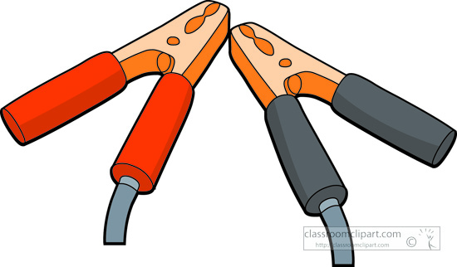
Explain why jumper cables and a lamp cord are made of both metal, a conductor, and plastic, an insulator.
Notes:
Instructional Approach(s): The teacher can pose the questions to the class, individual students, or let the students pair up to answer the questions. The teacher should not spend more than a few minutes on the slide. When ready, the teacher can click the mouse to show the answers.

Slide 46
The metal easily carries the electric charges while the plastic keeps the charges away from your hands.

Slide 47
Electron
Interview
[if time allows]
Notes:
Instructional Approach(s): The teacher should use this slide to introduce electron interview activity(on resource page)

Slide 48
Electric
Ilustrations
[if time allows]
Notes:
Instructional Approach(s): The teacher should use this slide to introduce electron illustrations activity(on resource page)

Slide 49
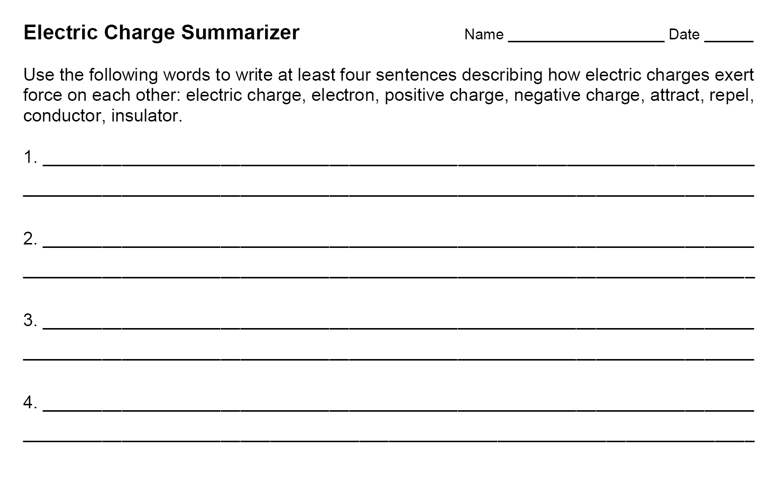
Notes:
Instructional Approach(s): Formative assessment. Each student should complete the summarizer. The teacher should use the summarizer to determine the level of student mastery and if differentiation is needed.

